Slide 1
A New Approach for Non-Interactive Zero-Knowledge from Learning with Errors
Brent Waters
Presented by William He

Slide 2
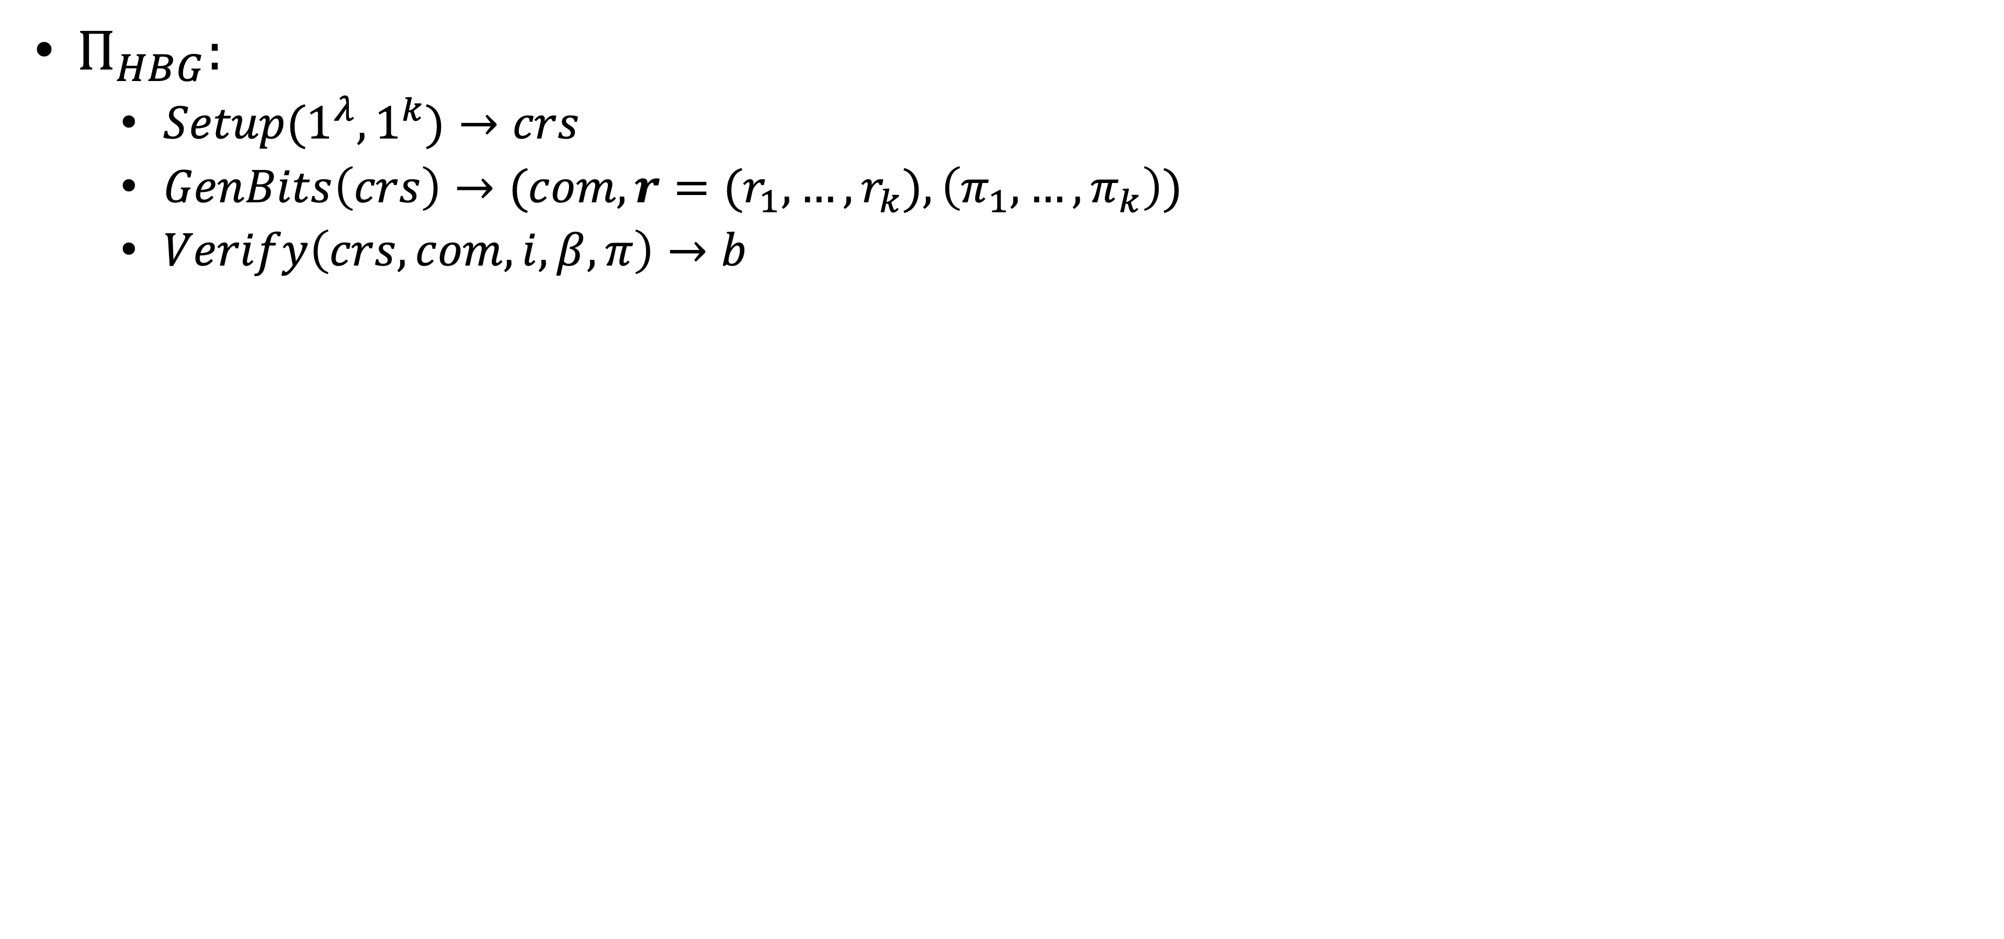
Hidden-Bits Generator

Slide 3
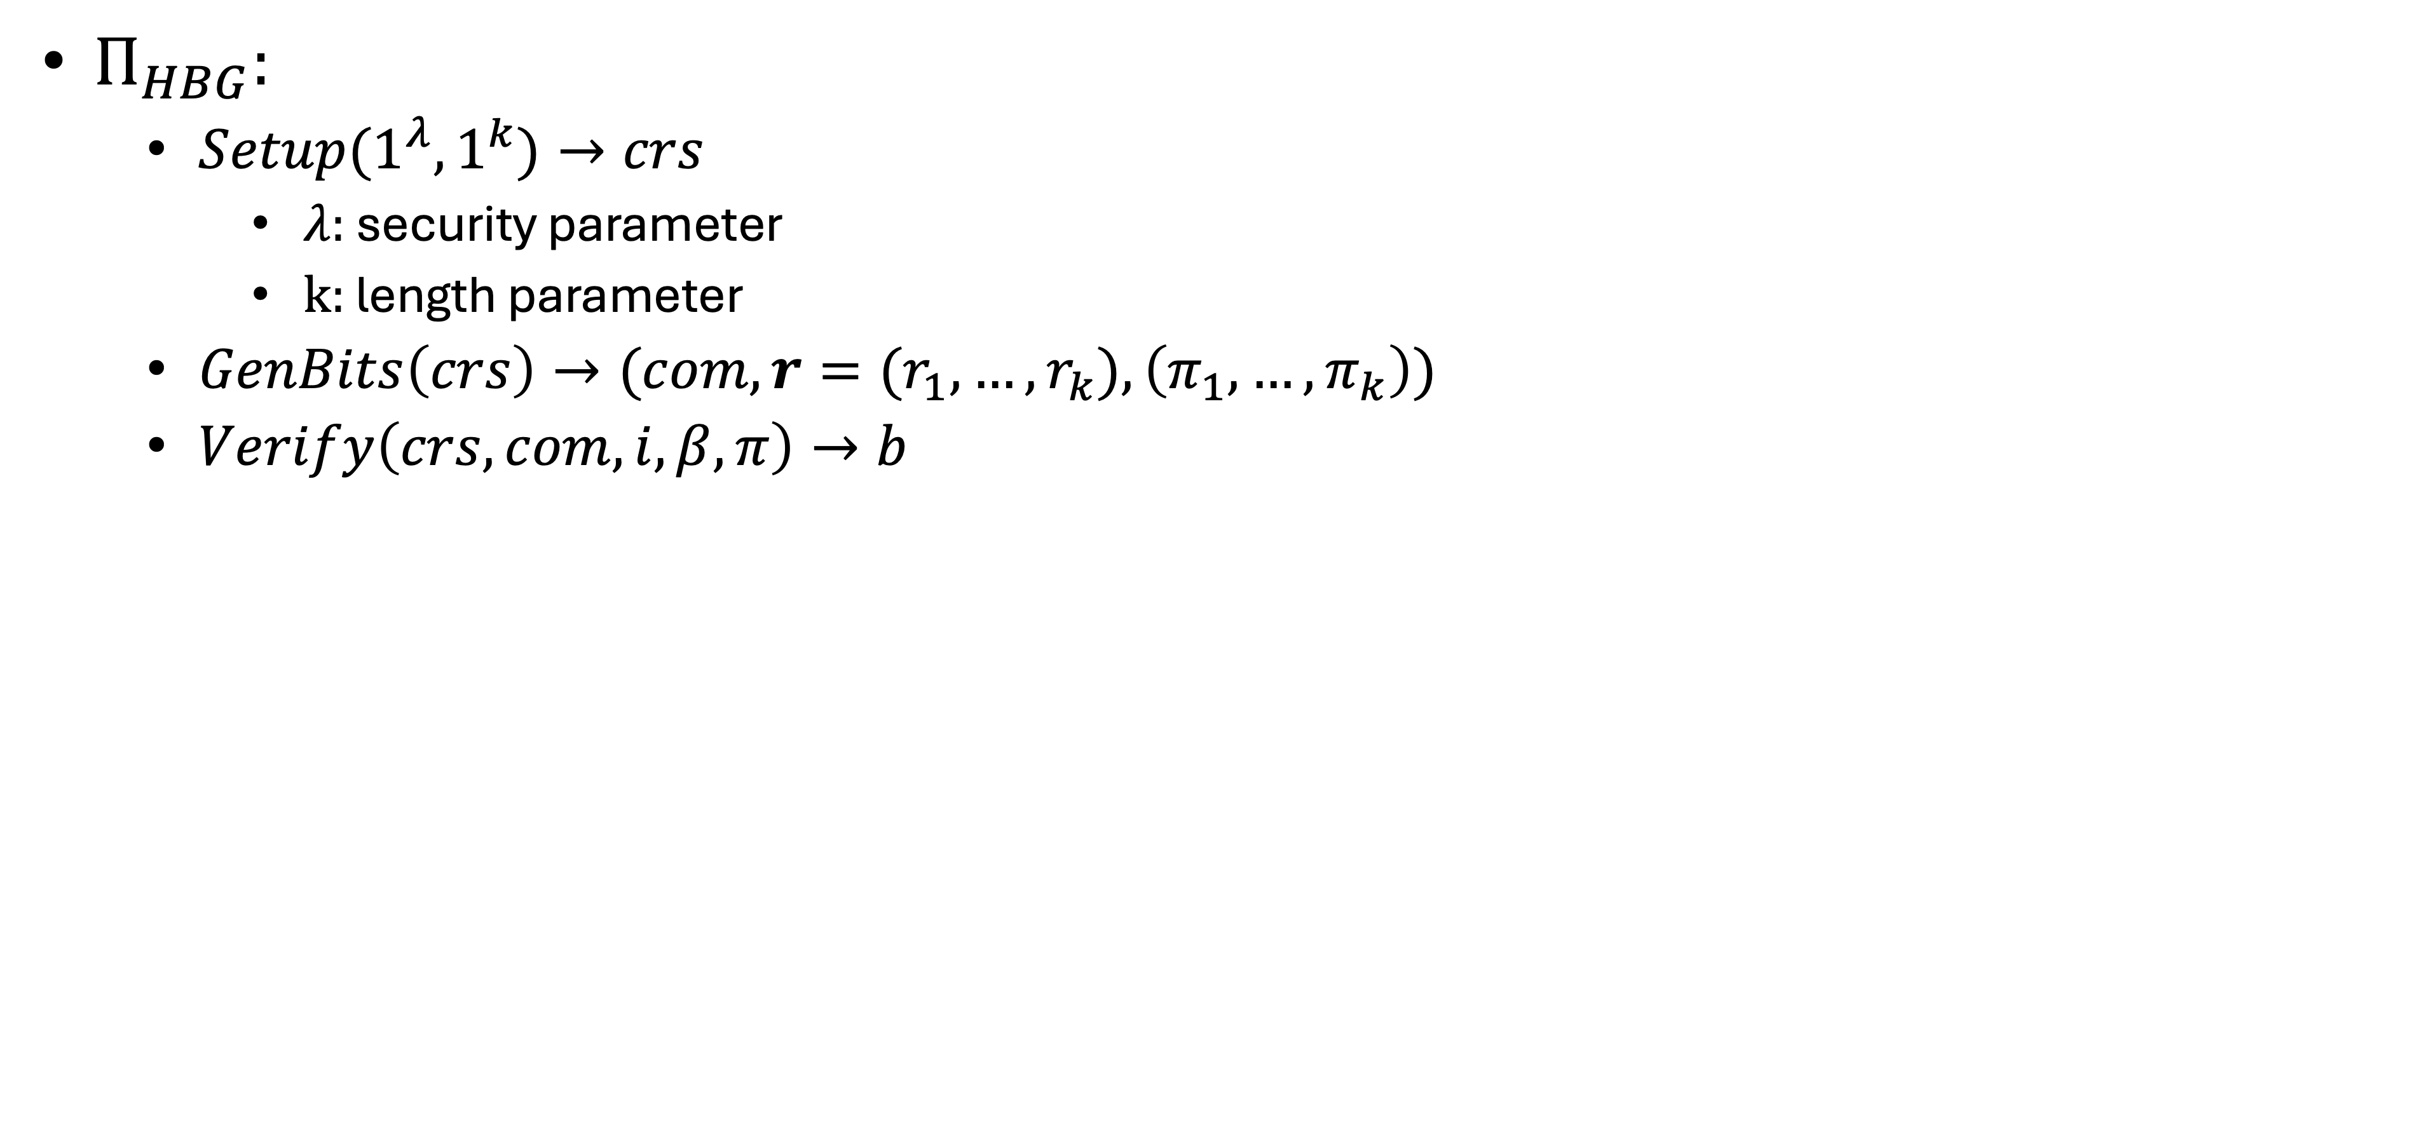
Hidden-Bits Generator

Slide 4
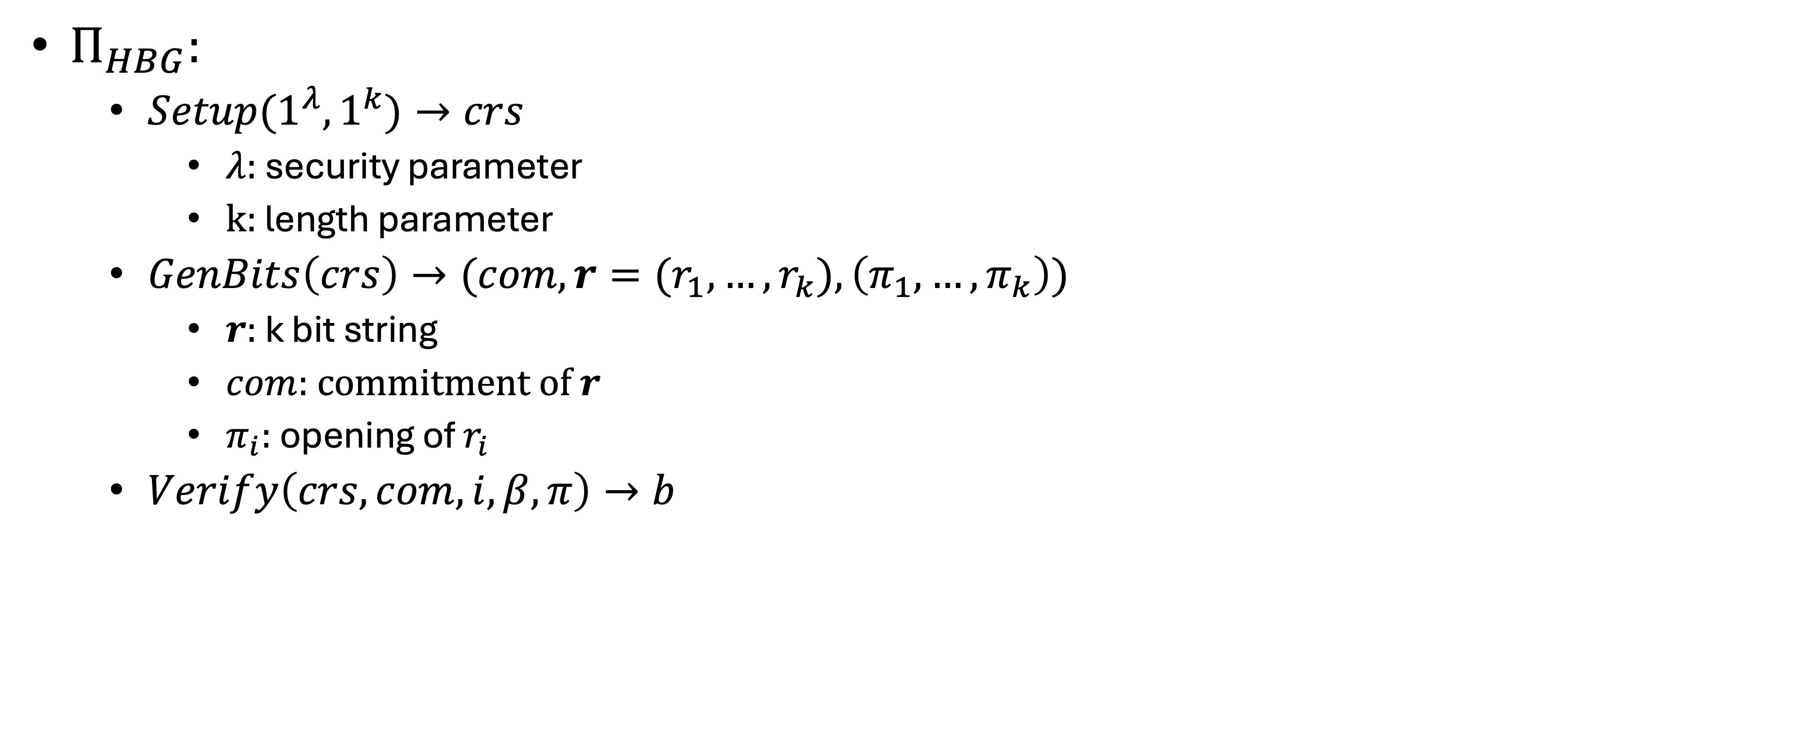
Hidden-Bits Generator

Slide 5
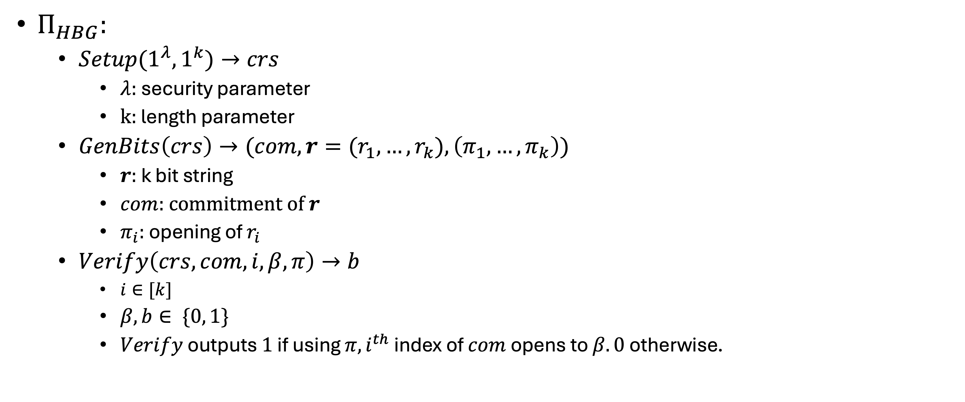
Hidden-Bits Generator

Slide 6
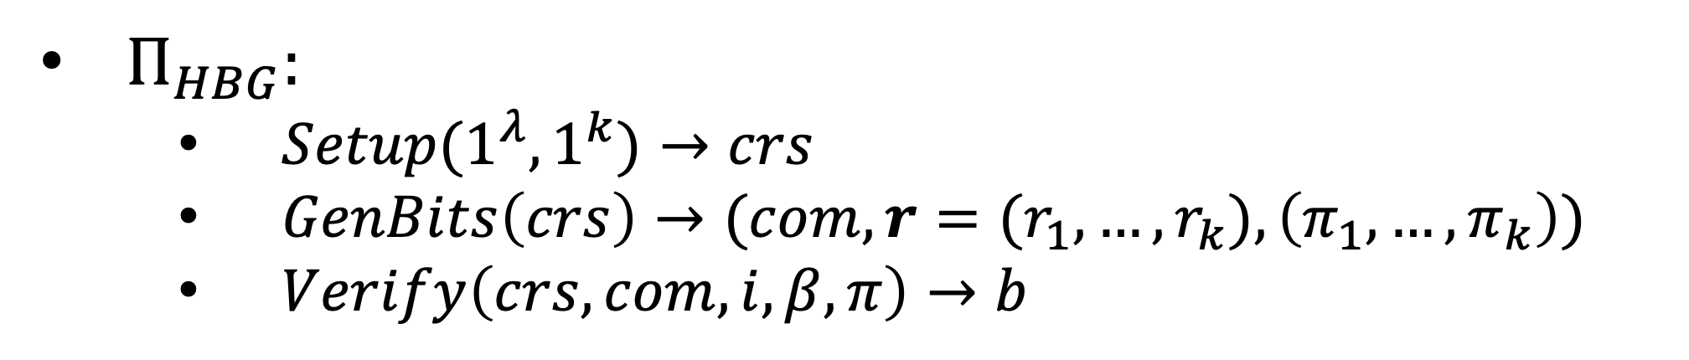
Hidden-Bits Generator
Correctness
Stat binding
(Adaptive) Comp hiding

Slide 7
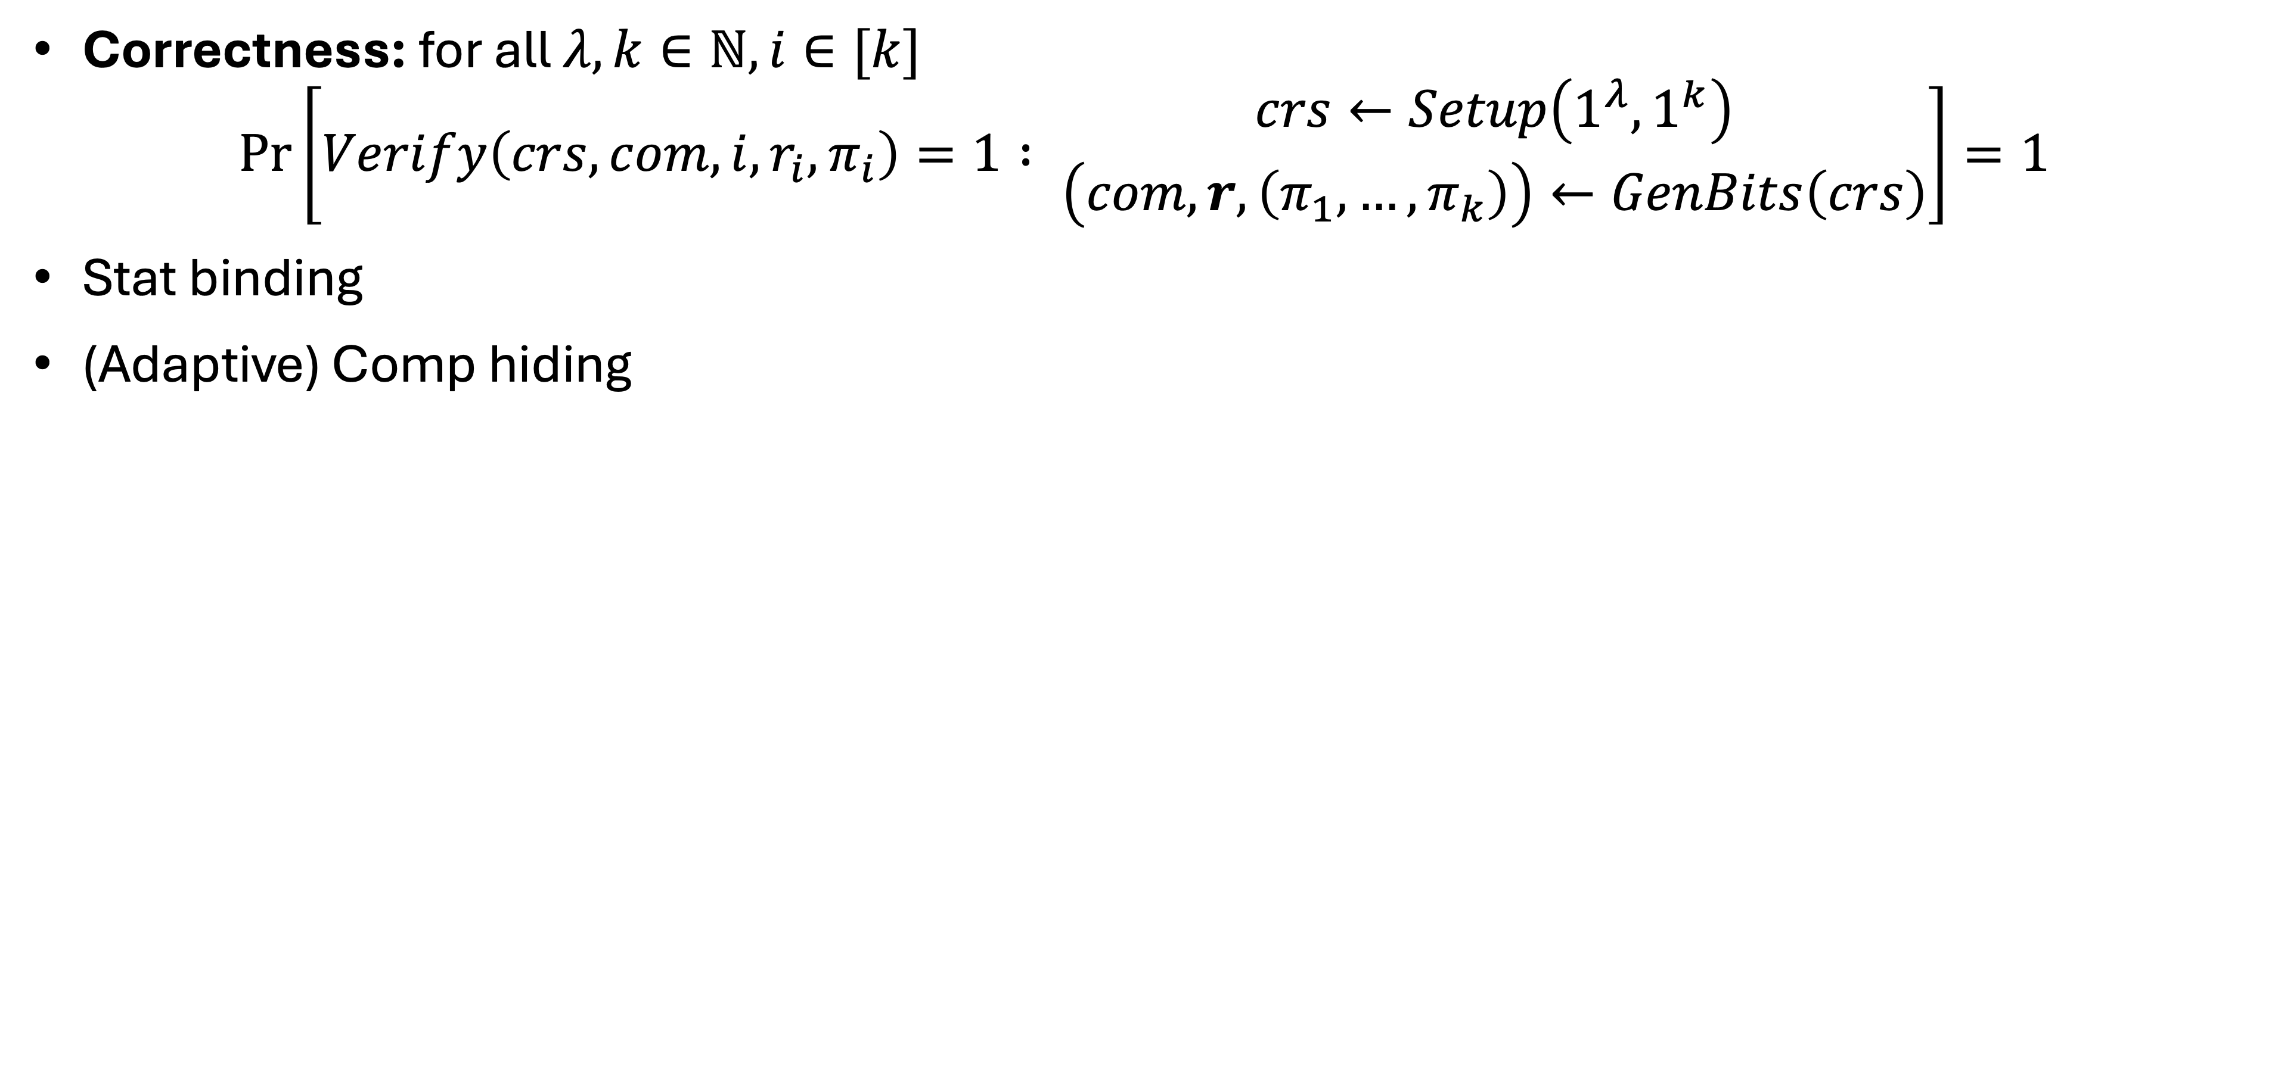
Hidden-Bits Generator

Slide 8
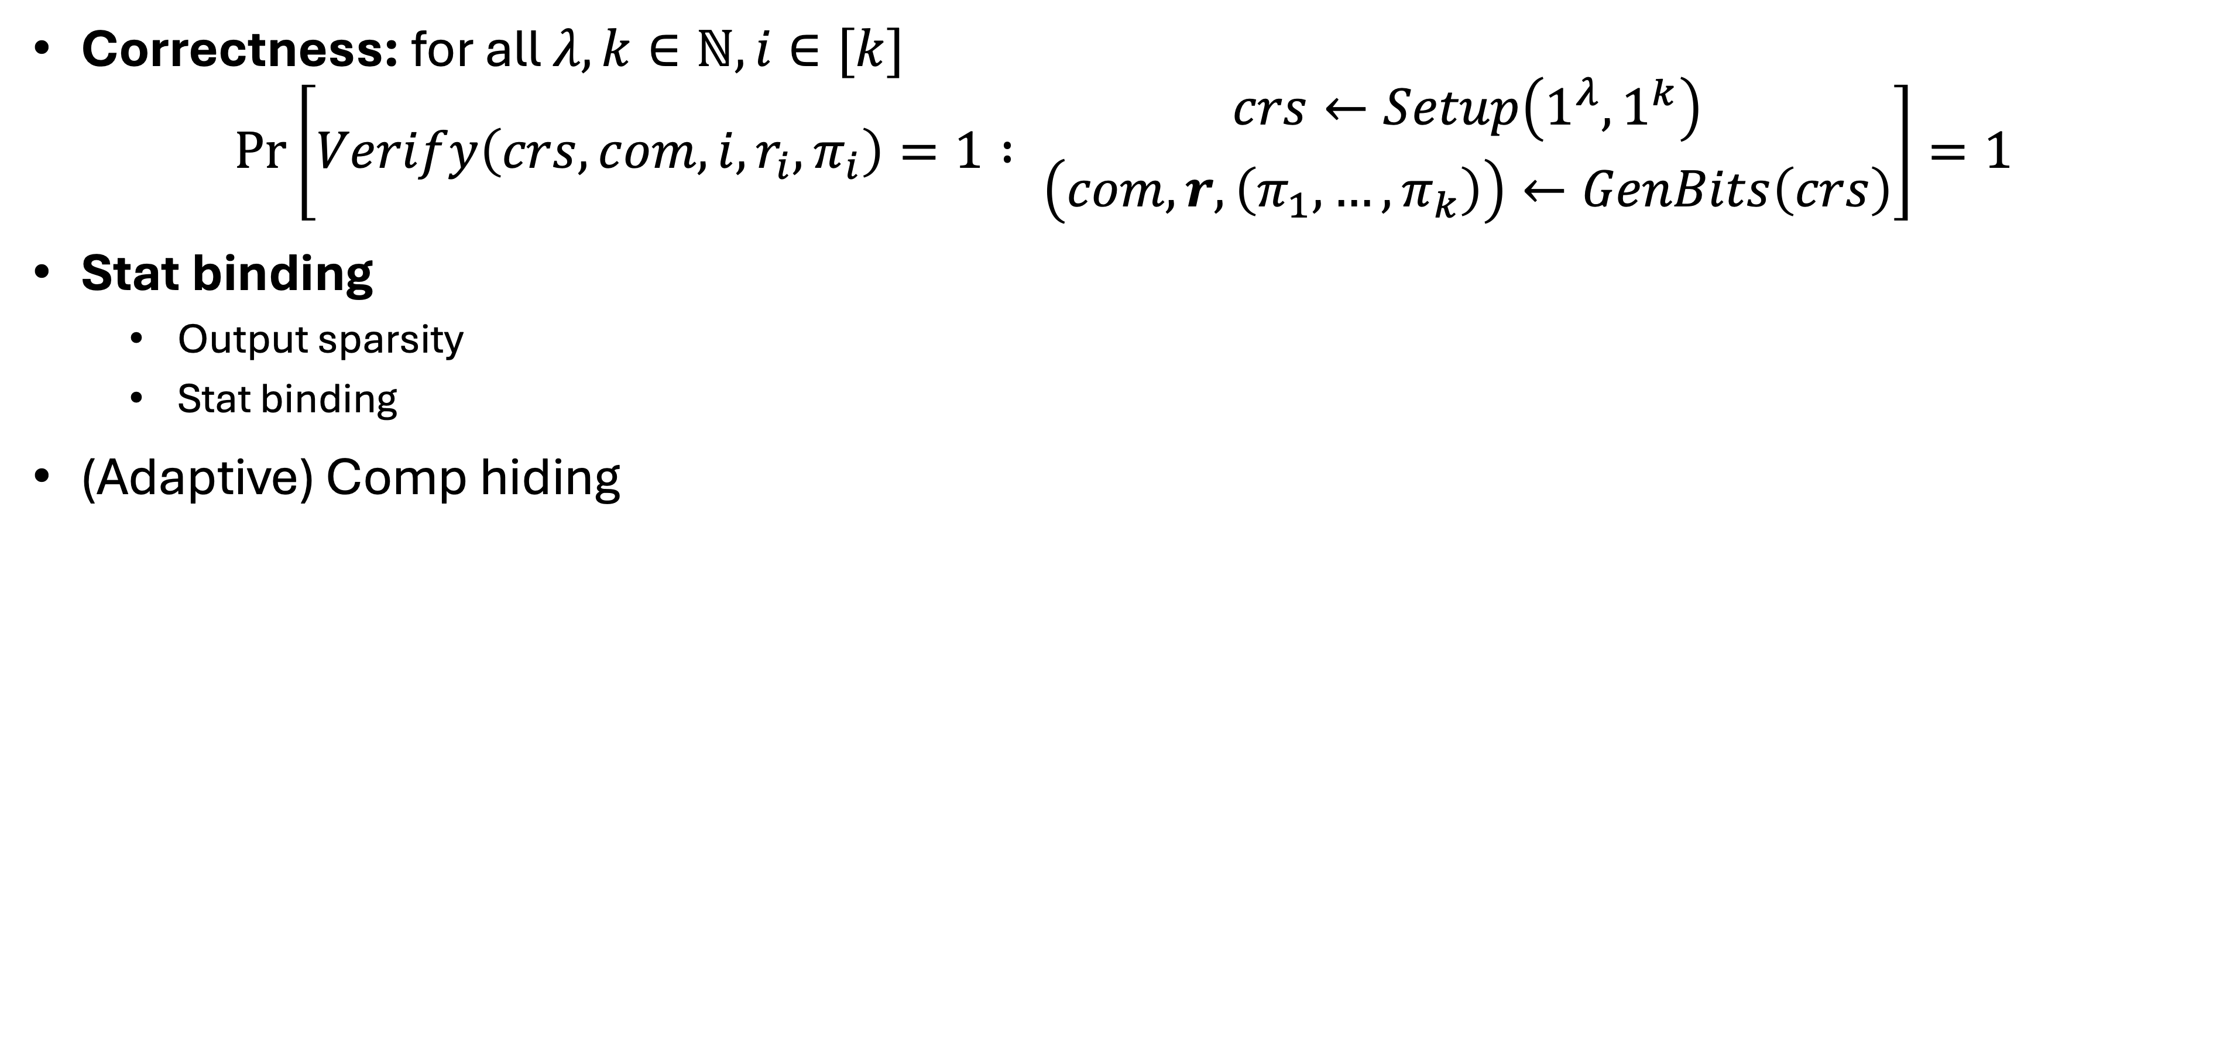
Hidden-Bits Generator

Slide 9
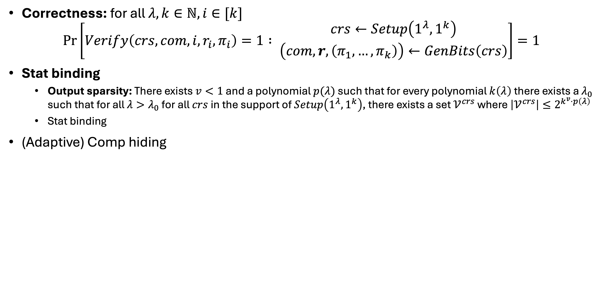
Hidden-Bits Generator

Slide 10
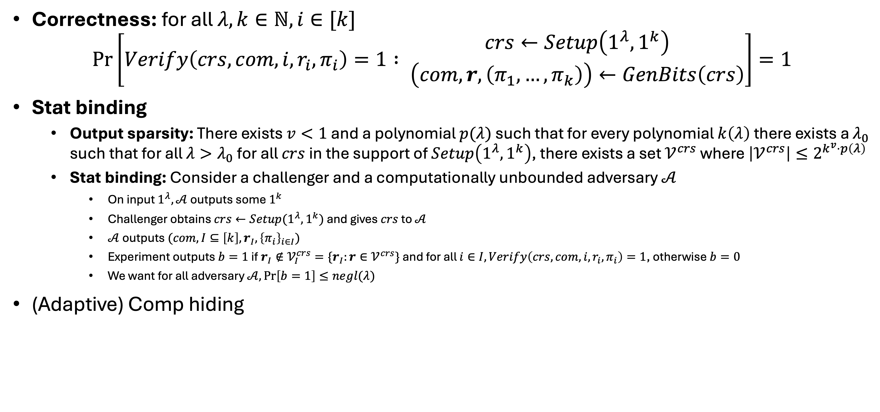
Hidden-Bits Generator

Slide 11
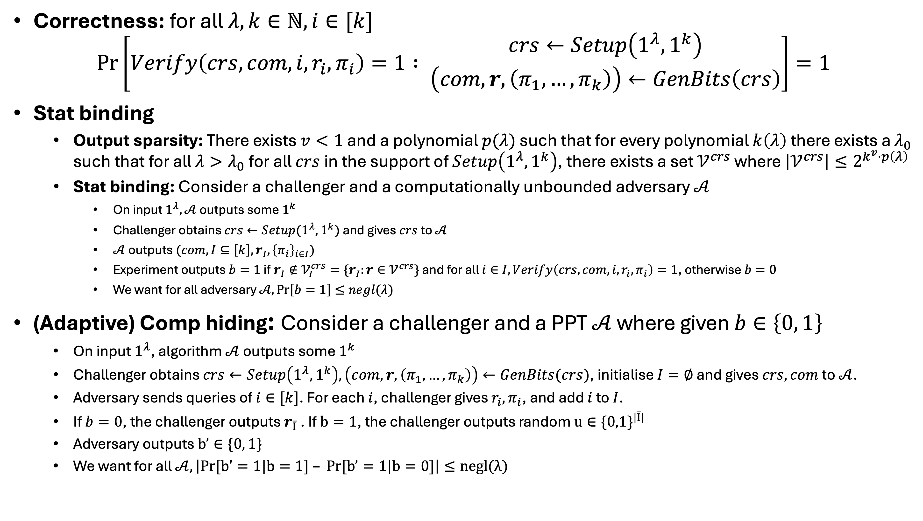
Hidden-Bits Generator

Slide 12
NIZK from Hidden-Bits Generator [KMY20]
If there exists a hidden-bits generator that satisfies our previous definition, then there exists a computational NIZK for all NP languages.

Slide 13
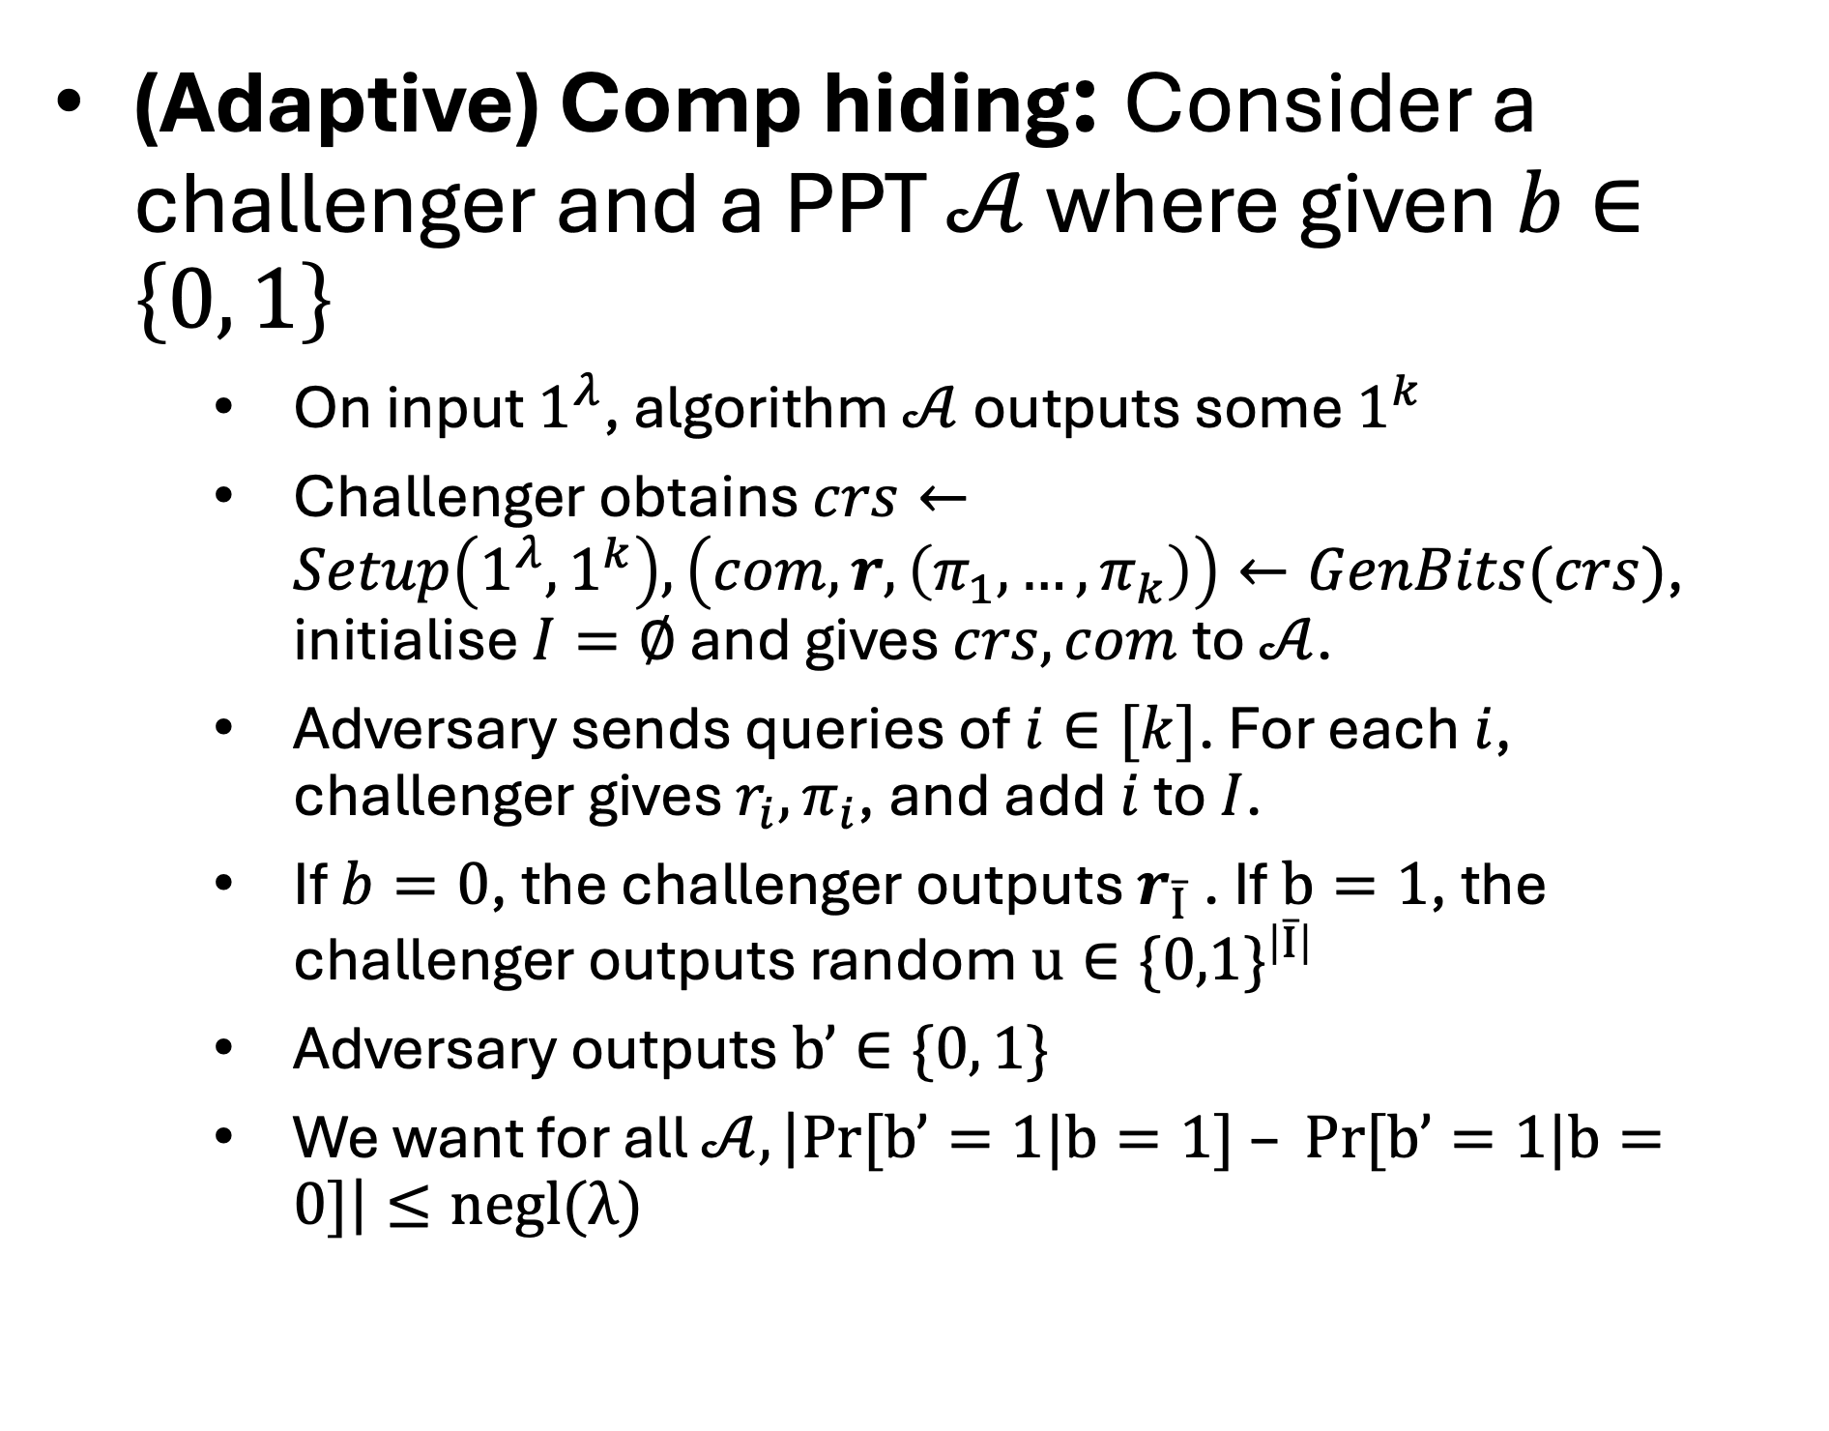
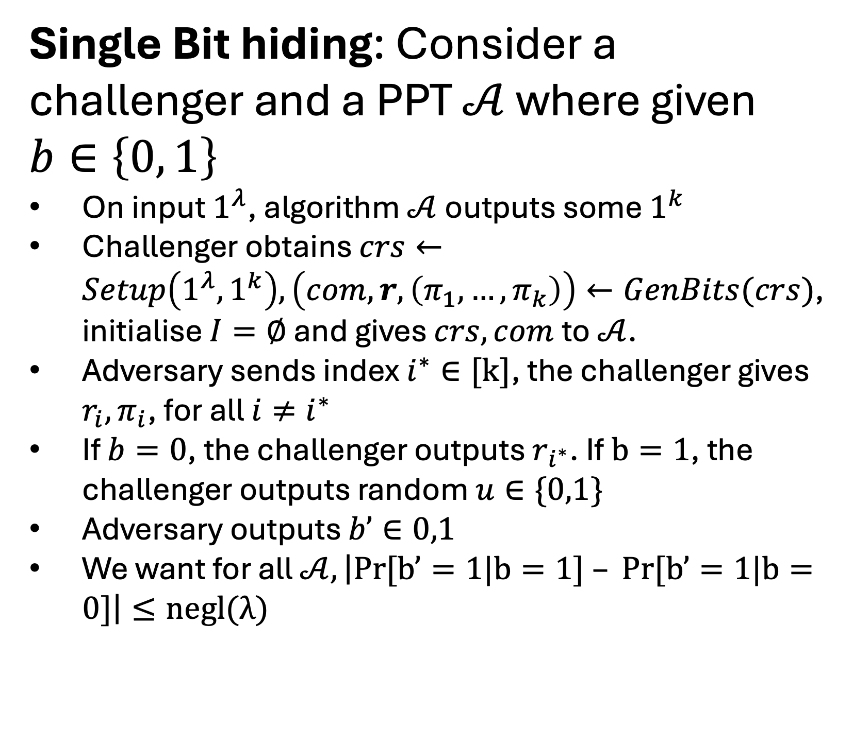
(Adaptive) Comp hiding vs Single Bit hiding

Slide 14
(Adaptive) Comp hiding vs Single Bit hiding
Theorem from Waters: If there exists a hidden-bits generator that satisfies single bit hiding property then it satisfies the adaptive computational hiding.

Slide 15
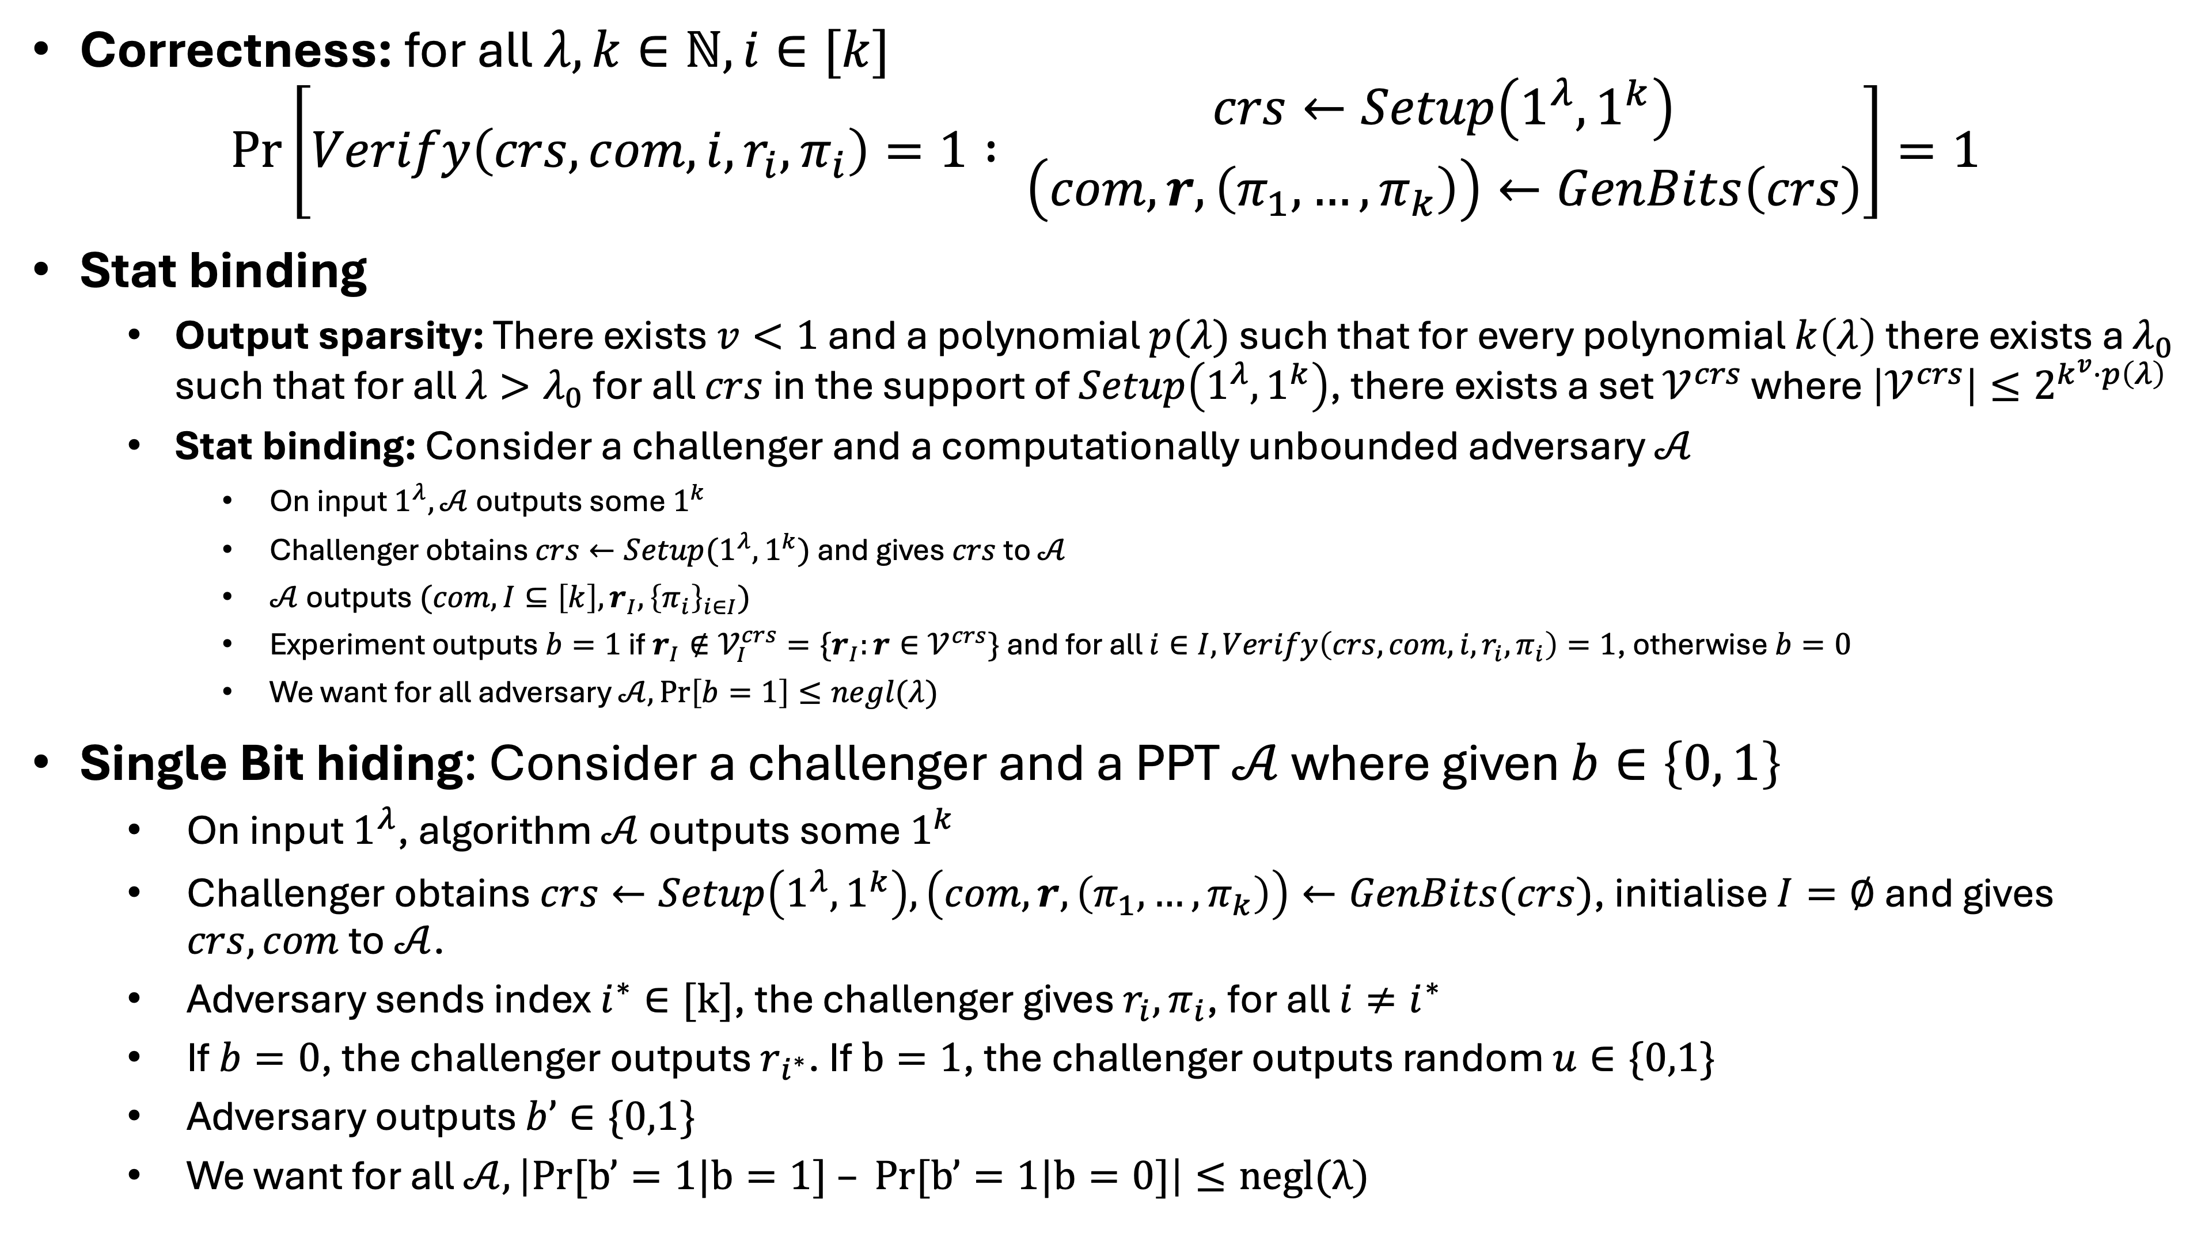
Hidden-Bits Generator

Slide 16
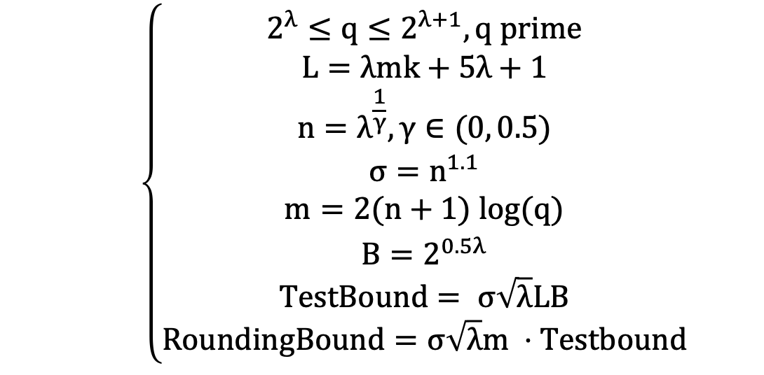
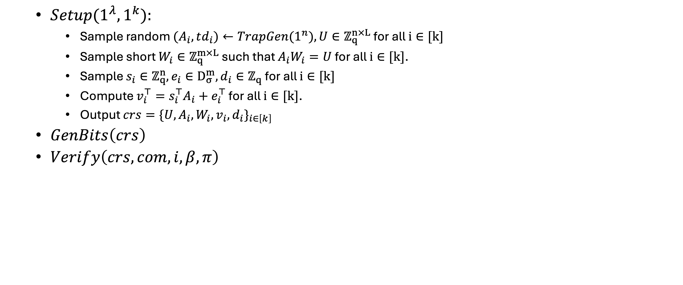
HBG construction

Slide 17
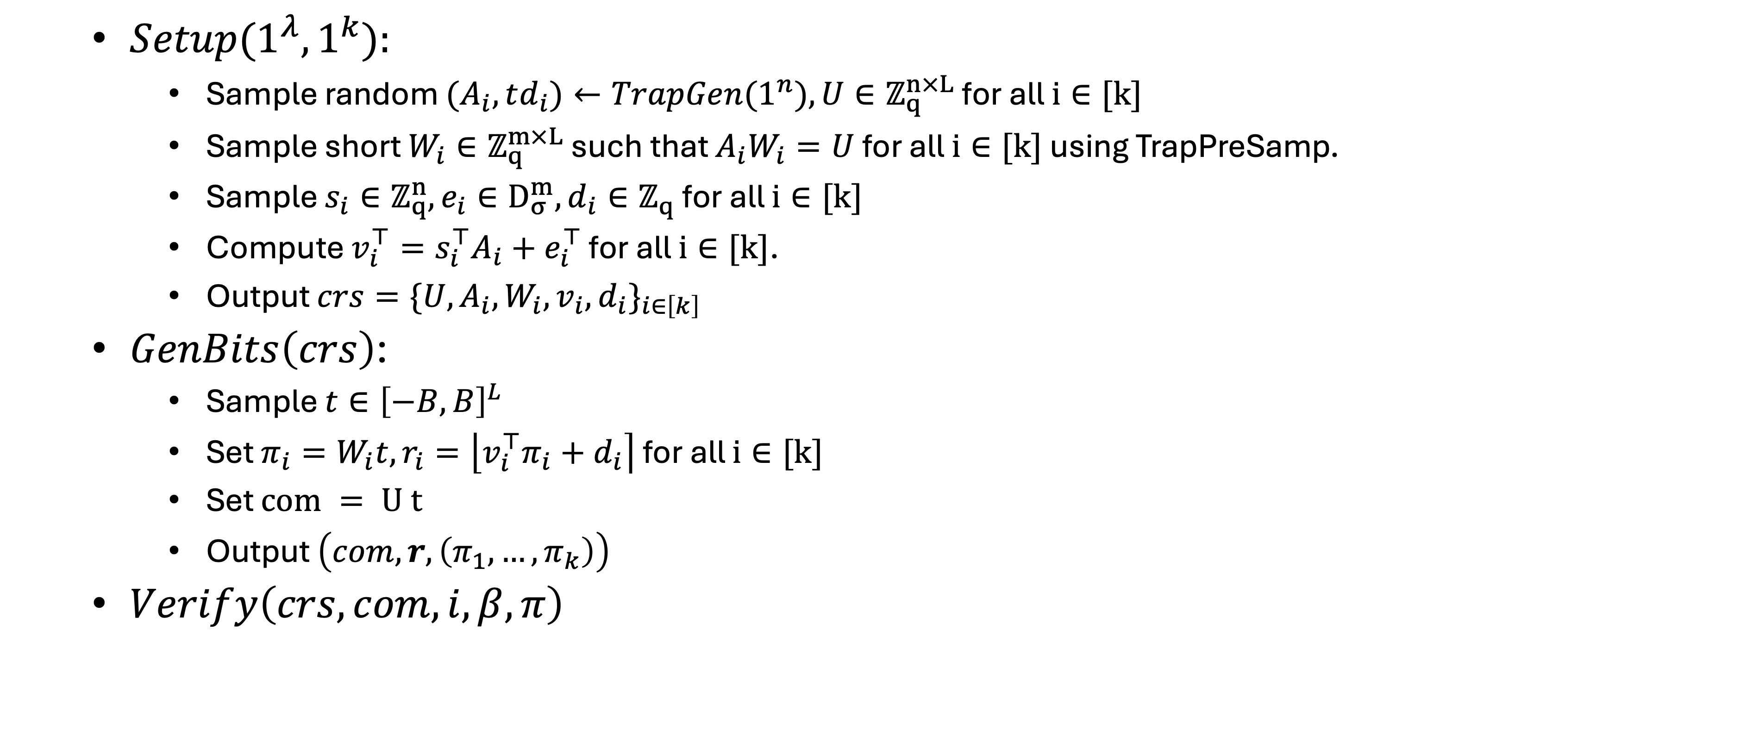
HBG construction

Slide 18
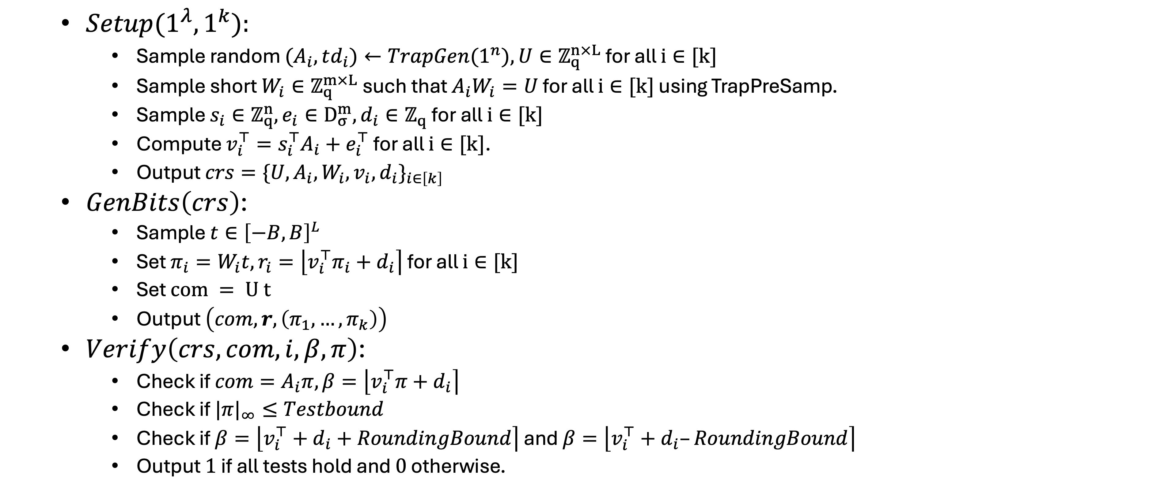
HBG construction

Slide 19
Negligible Correctness Error

Slide 20
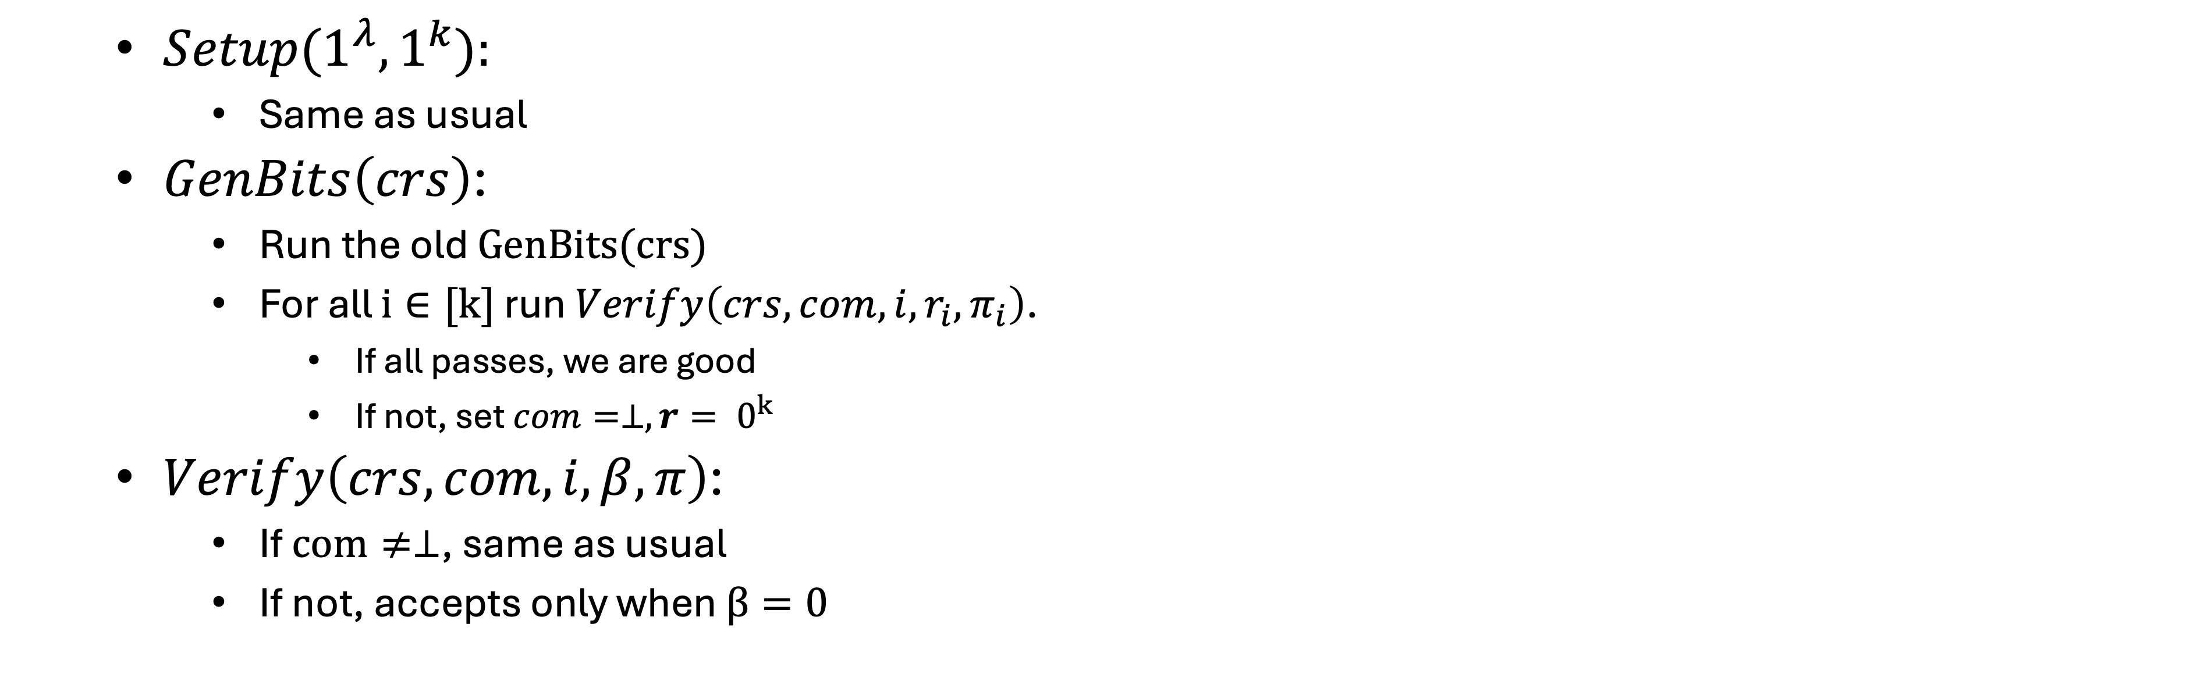
Negligible Error to Perfect Correctness
Perfect correctness
Effect on Stat binding
Effect on Single Bit Hiding

Slide 21
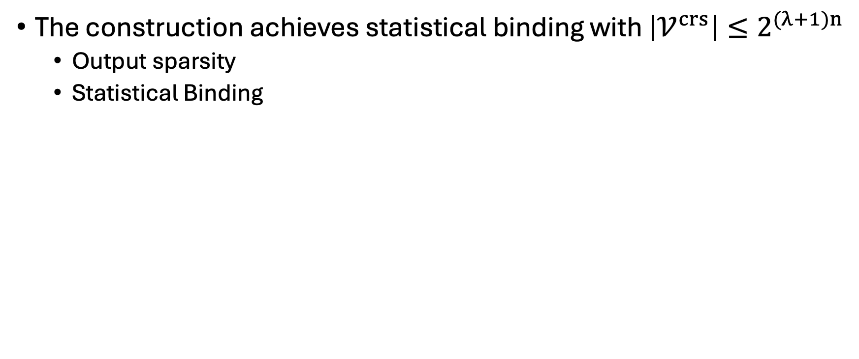
Binding Security
The construction achieves statistical binding with $\left|𝒱^{crs}\right|≤2^{(λ+1)n}$
Output sparsity
Statistical Binding

Slide 22
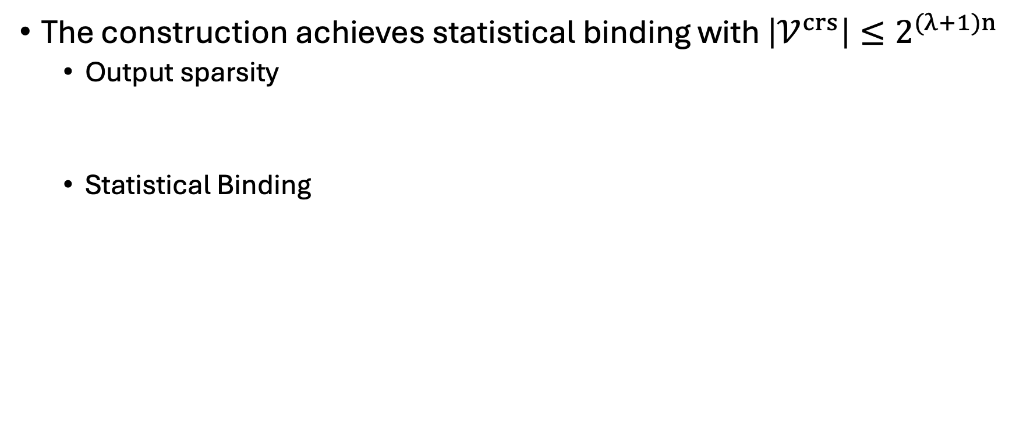
Binding Security
The construction achieves statistical binding with $\left|𝒱^{crs}\right|≤2^{(λ+1)n}$
Output sparsity
Statistical Binding

Slide 23
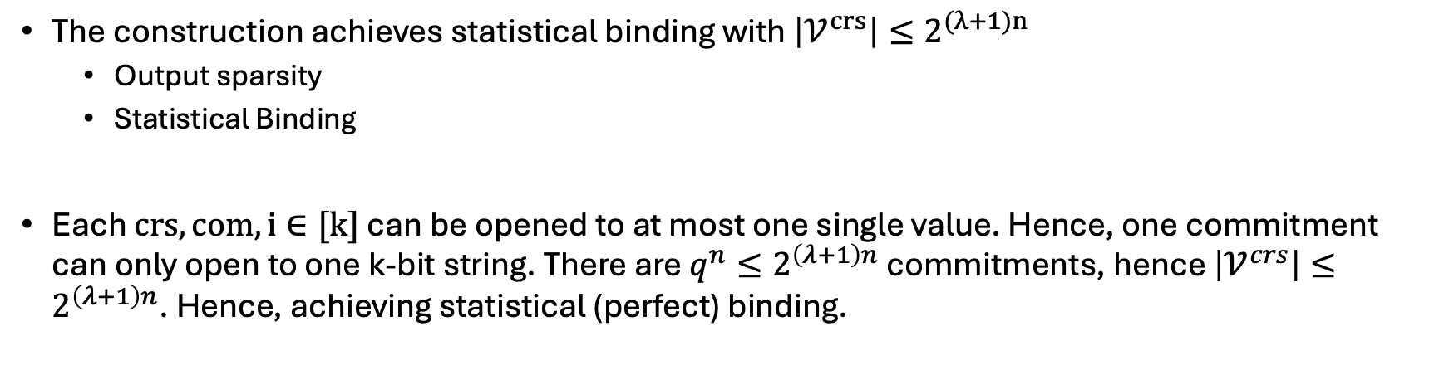
Binding Security
The construction achieves statistical binding with $\left|𝒱^{crs}\right|≤2^{(λ+1)n}$
Output sparsity
Statistical Binding
Each $crs, com, i∈[k]$ can be opened to at most one single value. Hence, one commitment can only open to one k-bit string. There are $q^{n}≤2^{\left(λ+1\right)n}$ commitments, hence $\left|𝒱^{crs}\right|≤2^{\left(λ+1\right)n}$. Hence, achieving statistical (perfect) binding.

Slide 24
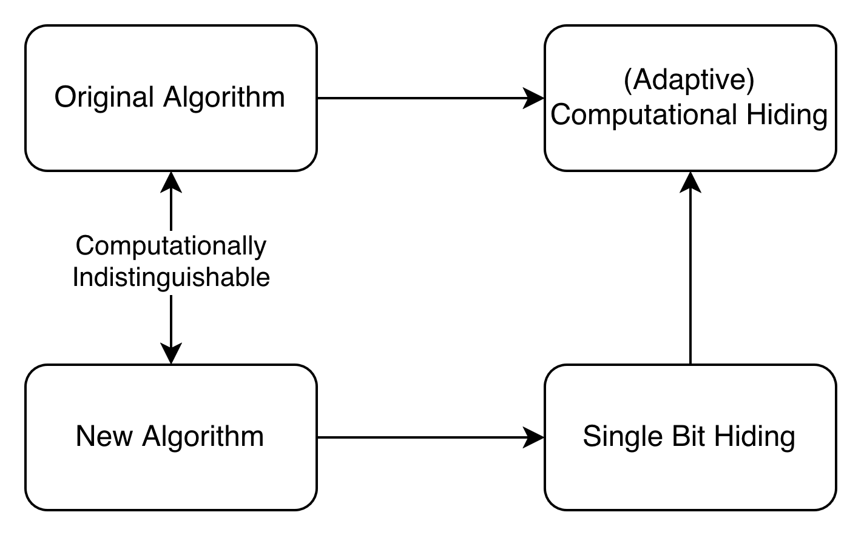
Hiding Security

Slide 25
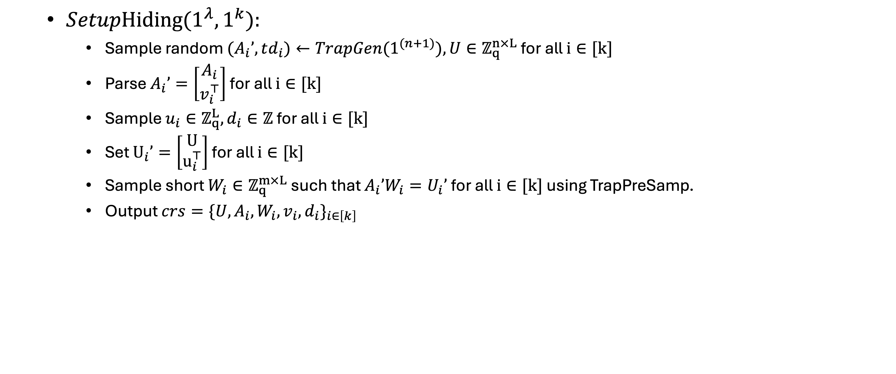
Hiding Security

Slide 26
Hiding Security
Theorem from Waters (paraphrased): The output of Setup and SetupHiding are computationally indistinguishable under LWE.

Slide 27
Hiding Security
Theorem from Waters (paraphrased): Except for negligible probability, SetupHiding can find a vector $c$ such that ${{\left\|c\right\|}_{∞} ≤5λ+1, W}_{i}c=0$ for all $i≠i*$ and $u_{i∗}^{⊤}c=\left\lfloor q/2\right\rfloor$

Slide 28
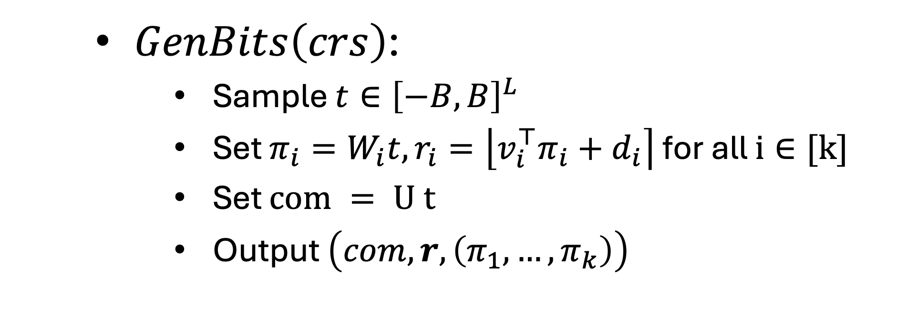
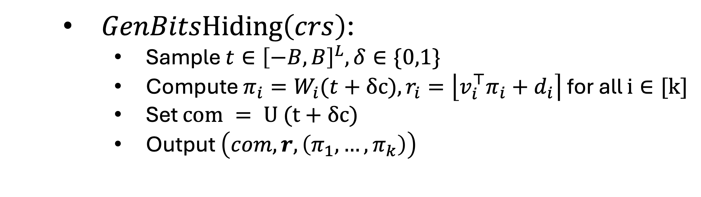
Smudging Lemma

Slide 29
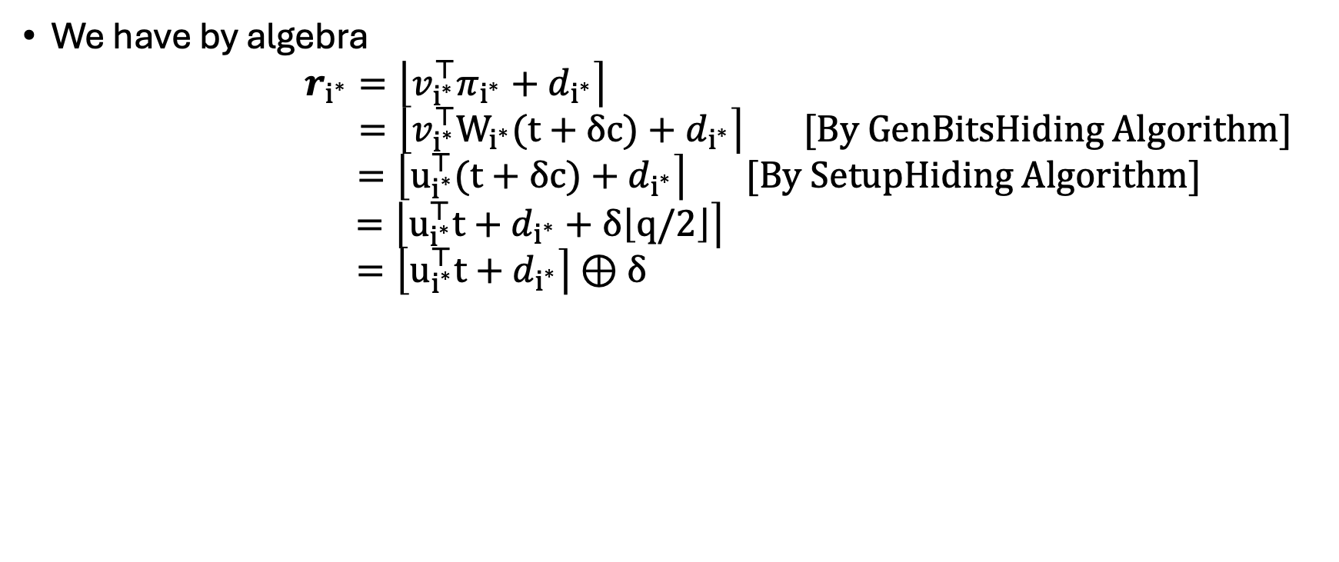
Hiding Security (continue)
We have by algebra
$$r_{i^{∗}}=\left\lfloor v_{i^{∗}}^{⊤}π_{i^{∗}}+d_{i^{∗}}\right\rceil$$
$$=\left\lfloor v_{i^{∗}}^{⊤}W_{i^{∗}}(t+δc)+d_{i^{∗}}\right\rceil [By GenBitsHiding Algorithm]$$
$$=\left\lfloor u_{i^{∗}}^{⊤}(t+δc)+d_{i^{∗}}\right\rceil [By SetupHiding Algorithm]$$
$$=\left\lfloor u_{i^{∗}}^{⊤}t+d_{i^{∗}}+δ\left\lfloor q/2\right\rfloor \right\rceil$$
$$=\left\lfloor u_{i^{∗}}^{⊤}t+d_{i^{∗}}\right\rceil ⊕δ$$

Slide 30
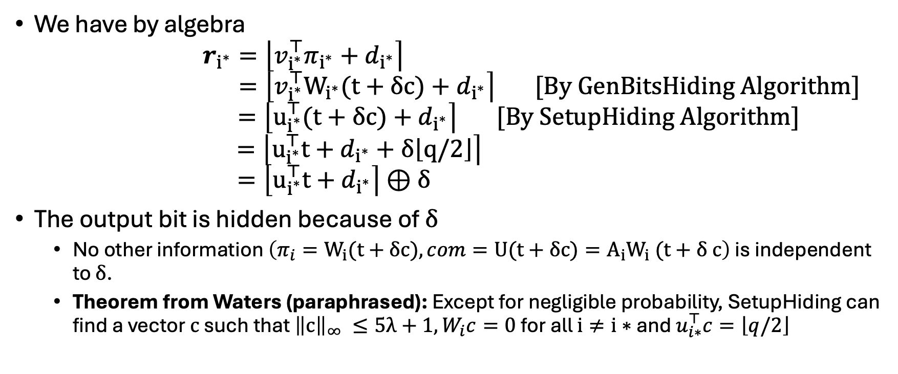
Hiding Security (continue)
We have by algebra
$$r_{i^{∗}}=\left\lfloor v_{i^{∗}}^{⊤}π_{i^{∗}}+d_{i^{∗}}\right\rceil$$
$$=\left\lfloor v_{i^{∗}}^{⊤}W_{i^{∗}}(t+δc)+d_{i^{∗}}\right\rceil [By GenBitsHiding Algorithm]$$
$$=\left\lfloor u_{i^{∗}}^{⊤}(t+δc)+d_{i^{∗}}\right\rceil [By SetupHiding Algorithm]$$
$$=\left\lfloor u_{i^{∗}}^{⊤}t+d_{i^{∗}}+δ\left\lfloor q/2\right\rfloor \right\rceil$$
$$=\left\lfloor u_{i^{∗}}^{⊤}t+d_{i^{∗}}\right\rceil ⊕δ$$
The output bit is hidden because of $δ$
No other information $\left(π_{i}=W_{i}(t+δc),com=U(t+δc)=A_{i}W_{i} (t+δ c\right)$ is independent to $δ$.
Theorem from Waters (paraphrased): Except for negligible probability, SetupHiding can find a vector $c$ such that ${{\left\|c\right\|}_{∞} ≤5λ+1, W}_{i}c=0$ for all $i≠i∗$ and $u_{i∗}^{⊤}c=\left\lfloor q/2\right\rfloor$

